Slide 1





INDUSTRIAL PROJECT
Detection and Monitoring
By Devarsh Mistry

Slide 2
TABLE OF CONTENTS
Introduction
Tools and Technology
Architecture Overview
Conclusion
01
02
03
04

Slide 3

INTRODUCTION
Object detection and tracking project utilizing the YOLO (You Only Look Once) model along with additional functionalities for annotation and counting.
This project aims to detect and track objects in a video stream, annotate them with bounding boxes and labels, and count the occurrences of each detected object over time.

Slide 4


Tools and Technology
YOLO (You Only Look Once)
YOLO is a state-of-the-art object detection algorithm that allows for real-time object detection in images and videos.
Ultralytics YOLO
Ultralytics YOLO is a PyTorch-based implementation of the YOLO object detection algorithm.
Python
Python is a widely-used programming language, especially in the field of data science, machine learning, and computer vision

Slide 5







Architecture Overview
Input Module
Object Detection with YOLO
Object Tracking
The input module is responsible for capturing video data from a specified source, such as a file or camera feed. It uses libraries like OpenCV to read video frames in real-time
Once video frames are captured, they are passed through the YOLO model for object detection.
The detected objects are then passed through an object tracking module.

Slide 6
Architecture Overview
Counting
Data Storage
Conversion Tools
The system keeps track of the occurrences of each detected object class over the duration of the video
Tracking and counting information, such as tracker IDs, class names, and total counts per class, are stored in CSV files
Additional tools like labelme2Yolo may be used for converting annotations from one format to another, such as from LabelMe XML format to YOLO format

Slide 7
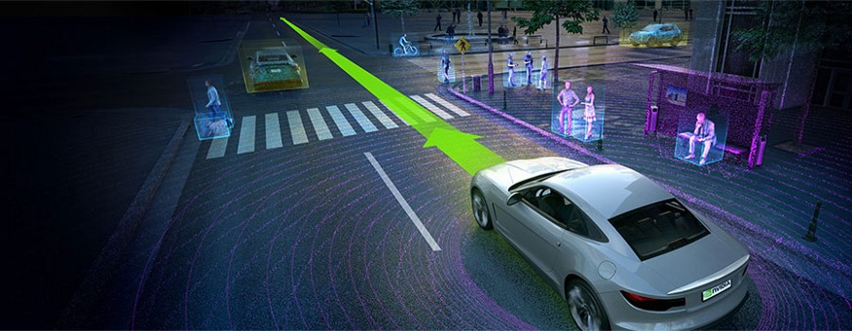

Conclusion
This project integrates YOLO object detection with tracking, annotation, and counting functionalities, using tools like OpenCV and LabelMe.
It enables real-time detection, tracking, and monitoring of objects in video streams, facilitating tasks such as surveillance and object analysis.
The system outputs annotated videos and stores tracking data for further analysis.

Slide 8

THANK YOU!

